Slide 1

ENERGY LEVELS
AND
SPECTRA

Slide 2
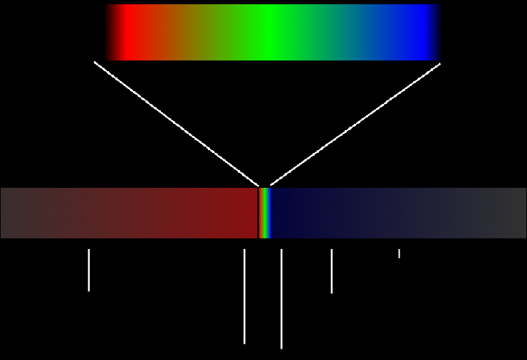
The Electromagnetic Spectrum
700 nm
400 nm
Visible
wavelength
frequency
Gamma
10^{-11 –} 10⁻¹³ m
Microwaves
cms
Radio 1 - 2000 m
X-rays 10⁻⁹ – 10⁻¹¹ m
IR 10⁻³ – 10⁻⁷ m
UV 10⁻⁷ – 10⁻⁹ m

Slide 3


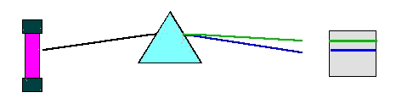
Continuous Spectrum from a hot solid or incandescent liquid
e.g. hot filament
Part of the Line Spectrum for
Hydrogen gas
Glowing gas
Line Spectrum,
unique to the gas

Slide 4
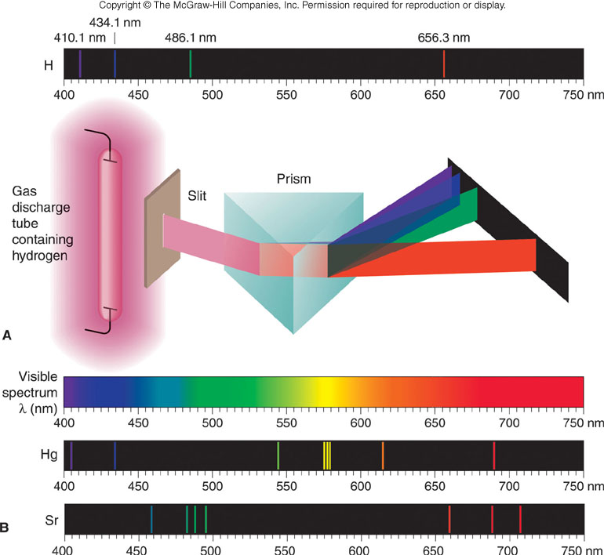
The line spectra of several elements
Note: prism separates the different λ’s, and red light bends least

Slide 5
THE HYDROGEN ATOM
Because energy within the atom is quantised, the electron can only occupy certain energy levels.
The electron is normally found in the lowest energy state, because this is the most stable. This is called the GROUND STATE.
The electron can be excited to higher energy levels electrically in a discharge tube or by heating.
Given enough energy, the electron can be stripped away from the atom. IONISATION has occurred
e⁻
Ionisation Energy
+
e⁻
e⁻
3rd Excited State
e⁻
1st Excited State
2nd Excited State
e⁻

Slide 6
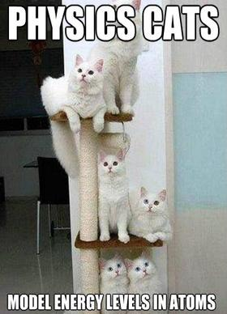

Slide 7




Excited electrons lose their excess energy as photons of electromagnetic radiation.
+
Photon of electromagnetic radiation
e⁻
e⁻
e⁻
Photon of electromagnetic radiation
Wave length of released photon

Slide 8
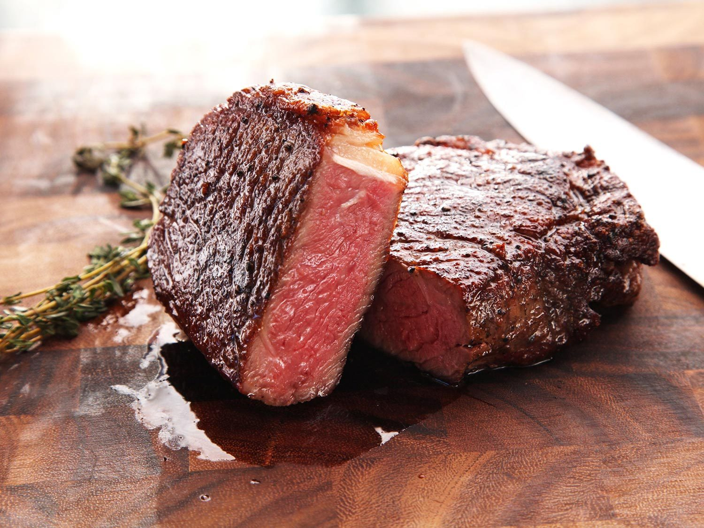
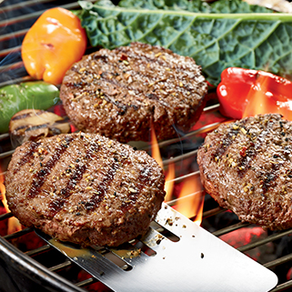
Check your Understanding
Why does a 300g piece of steak have more ENERGY than a 300g burger pattie?
Both are beef, but the burger is in its GROUND state.

Slide 9
The energy levels of en electron in a hydrogen atom can be represented by the formula:
in electron volts (eV)
(1 eV is the energy an electron would have if it had been accelerated through a p.d. of one volt. 1 eV = 1.6 x 10⁻¹⁹ J)
For the ground state n = 1, so E = -13.6 eV
For the first excited state n = 2, so E = - 3.4 eV
For the second excited state n = 3, so E = - 1.51 eV
For the third excited state n = 4, so E = - 0.85 eV

Slide 10

E_{n} eV
ionisation
n = ∞
0
e⁻
e⁻
- 0.85
e⁻
e⁻
n = 4
- 1.51
e⁻
e⁻
n = 3
- 3.4
n = 2
- 13.6
n = 1
ground state
Spectrum
λ
Lyman series in UV
BALMER series VISIBLE
e⁻

Slide 11
E_{n} eV
ionisation
n = ∞
0
- 0.85
n = 4
- 1.51
n = 3
- 3.4
n = 2
- 13.6
n = 1
ground state
QUESTION. The Paschen Series in the Hydrogen Spectrum refers to transitions down to the second excited state. These lines are in the Infra Red. Find the longest of these wavelengths.
This will involve the smallest energy change…. n = 4 to n = 3
ΔE = E₄ – E₃ = - 0.85 – (-1.51) = 0.66 eV. 0.66 x 1.6 x 10⁻¹⁹ = 1.056 x 10⁻¹⁹ J

Slide 12
E_{n} eV
ionisation
n = ∞
0
- 0.85
n = 4
- 1.51
n = 3
- 3.4
n = 2
- 13.6
n = 1
ground state
N.B. All energies are NEGATIVE.
REASON: The maximum energy is the energy to ionise the electron. However an ionised electron feels no attraction to the nucleus so it must have zero potential energy.
It follows that energies less than the ionisation energy must be negative
e⁻

Slide 13
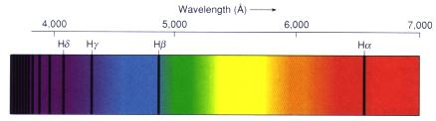
Absorption
Dark hydrogen absorption lines appear against a continuous visual spectrum, the light in the spectrum absorbed by intervening hydrogen atoms

Slide 14
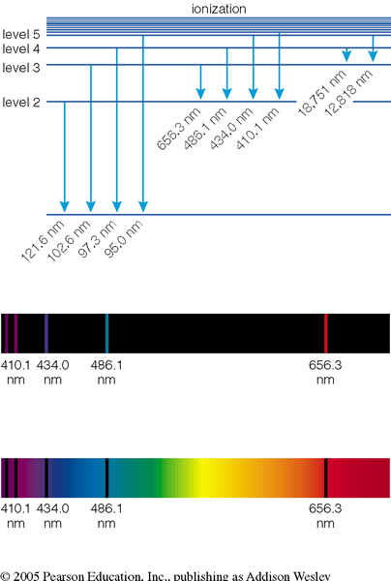
How does light tell us what things are made off?
Every chemical element has its own unit spectral fingerprint.
We can study the chemical composition of an astronomical object by observing its absorption or emission spectrum.
Emission spectrum of Hydrogen
Absorption spectrum of Hydrogen
With a thermal spectrum background.

Slide 15
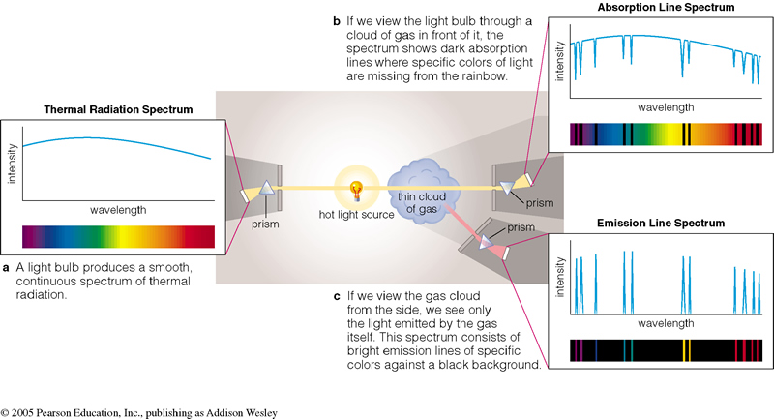
Astronomical Spectra
We can learn a lot about a astronomical object by studying the spectra of the object….
There are three basic types of spectra:
a. Thermal radiation Spectra: All objects with a finite temperature emit thermal radiation.
b. Absorption Line Spectra:
c. Emission Line Spectra:

Slide 16





Colors of various gases

Slide 17
Argon

Slide 18
Helium
580

Slide 19
Hydrogen
420
650

Slide 20
Krypton

Slide 21
Neon
460
735

Slide 22
Xenon

